Slide 1
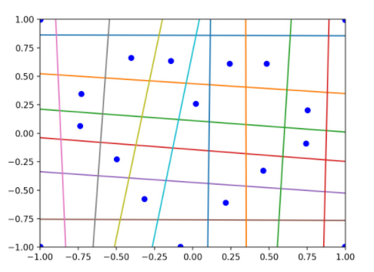














$$y_{14}$$
$$y_{13}$$
$$y_{12}$$
$$y_{11}$$
$$y_{10}$$
$$y_{9}$$
$$y_{8}$$
$$y_{7}$$
$$y_{6}$$
$$y_{5}$$
$$y_{4}$$
$$y_{3}$$
$$y_{2}$$
$$y_{1}$$

Slide 2
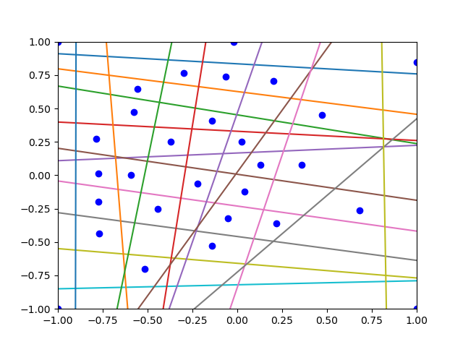
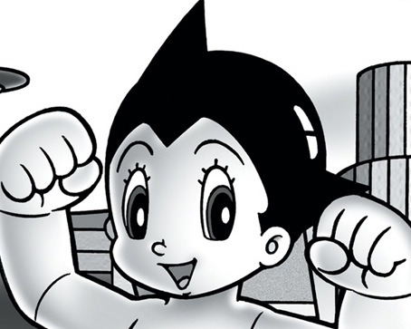



















$$y_{15}$$
$$y_{17}$$
$$y_{19}$$
$$y_{16}$$
$$y_{18}$$
4
3
$$y_{1}$$
13
$$y_{2}$$
14
12
11
$$y_{3}$$
15
10
$$y_{4}$$
24
25
16
23
26
$$y_{5}$$
27
9
$$y_{6}$$
8
17
22
21
28
$$y_{7}$$
$$y_{8}$$
18
20
29
7
$$y_{9}$$
19
6
$$y_{10}$$
5
1
$$y_{11}$$
421
$$y_{12}$$
$$y_{14}$$
$$y_{13}$$

Slide 3
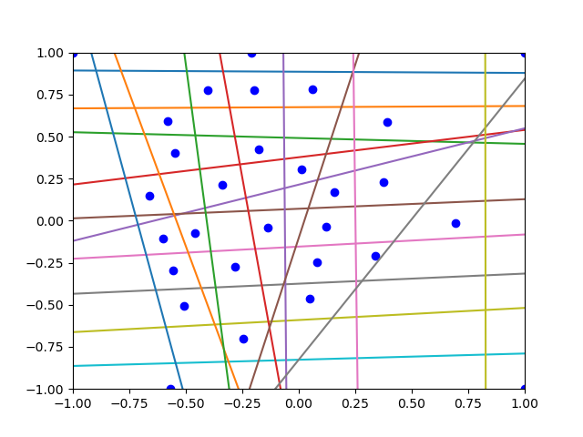





















$$y_{21}$$
$$y_{15}$$
$$y_{17}$$
$$y_{19}$$
$$y_{16}$$
$$y_{18}$$
4
3
$$y_{20}$$
$$y_{1}$$
13
$$y_{2}$$
14
12
11
$$y_{3}$$
15
10
$$y_{4}$$
24
25
16
23
26
$$y_{5}$$
27
9
$$y_{6}$$
8
17
22
21
28
$$y_{7}$$
$$y_{8}$$
18
20
29
7
$$y_{9}$$
19
6
$$y_{10}$$
5
1
30
421
$$y_{11}$$
$$y_{12}$$
$$y_{14}$$
$$y_{13}$$

Slide 4
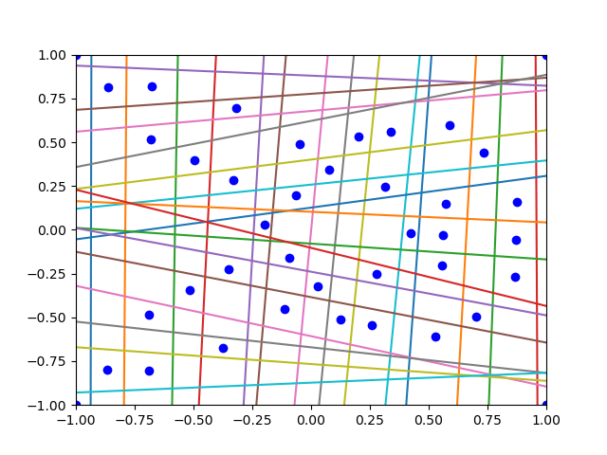

y16
y18
y20
y21
y26
y15
y17
y19
y22
y23
y24
y25
y27
y28
y29
y30
y1
4
3
y2
25
15
y3
26
24
16
14
23
17
y4
22
y5
27
18
13
y6
20
y7
28
21
19
12
y8
29
11
30
10
y9
y10
31
39
38
9
y11
35
32
40
36
37
8
y12
33
7
y13
y14
34
5
6
1
2

Slide 5
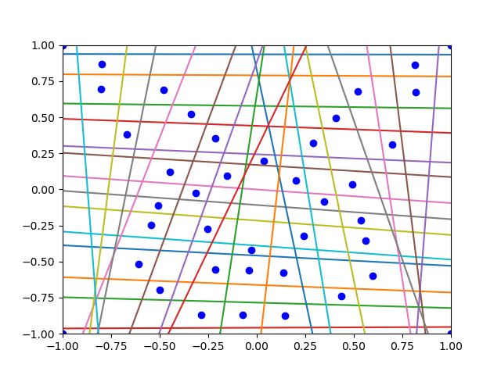
y16
y18
y20
y21
y26
y15
y17
y19
y22
y23
y24
y25
y27
y28
y29
y30
y1
4
3
y2
25
15
y3
26
24
16
14
23
17
y4
22
y5
27
18
13
y6
20
y7
28
21
19
12
y8
29
11
30
10
y9
y10
31
39
38
9
y11
35
32
40
36
37
8
y12
33
7
y13
y14
34
5
6
1
2

